Slide 1
COMP 4290
Week 5 - Wednesday

Slide 2
Last time
What did we talk about last time?
Key management

Slide 3
Questions?

Slide 4
Assignment 2

Slide 5
Project 2

Slide 6
Samuel Costa Presents

Slide 7
Hash Function Motivation

Slide 8
Where do passwords go?
What magic happens when you type your password into…
Windows or Unix to log on?
Amazon.com to make a purchase?
A Cobra Kai fan site so that you can post on the forums?
A genie from the 8th dimension travels back in time and checks to see what password you originally created

Slide 9
In reality…
The password is checked against a file on a computer
But, how safe is the whole process?
Cobra Kai fan site may not be safe at all
Amazon.com is complicated, much depends on the implementation of public key cryptography
What about your Windows or Unix computer?

Slide 10
Catch-22
Your computer needs to be able read the password file to check passwords
But even an administrator shouldn't be able to read everyone's passwords
Hash functions to the rescue!

Slide 11
Hash Functions Defined

Slide 12
Definition
A cryptographic (or one-way) hash function (called a cryptographic checksum in the book) takes a variable sized message M and produces a fixed-size hash code H(M)
Not the same as hash functions from data structures
The hash code produced is also called a digest
It can be used to provide authentication of both the integrity and the sender of a message
It allows us to store some information about a message that an attacker cannot use to recover the message

Slide 13
Crucial properties
Preimage Resistance
Given a digest, should be hard to find a message that would produce it
Collision Resistance
Should be hard to find any two messages that hash to the same digest (collision)
One-way property
Second Preimage Resistance
Given a message m, it should be hard to find a different message that has the same digest

Slide 14
Additional properties
Avalanching
A small change in input should correspond to a large change in output
Speed
It should be fast to compute a digest in software and hardware
Uniformity
Output should be a fixed length
Applicability
Hash function should work on a block of data of any size
No longer than retrieval from secondary storage

Slide 15
Common Hash Functions

Slide 16
MD5
Message Digest Algorithm 5
Very popular hashing algorithm
Designed by Ron Rivest (of RSA fame)
Digest size: 128 bits
Security
Completely broken
Reasonable size attacks (2³²) exist to create two messages with the same hash value
MD5 hashes are still commonly used to check to see if a download finished without error

Slide 17
SHA family
Secure Hash Algorithm
Created by NIST
SHA-0 was published in 1993, but it was replaced in 1995 by SHA-1
The difference between the two is only a single bitwise rotation, but the NSA said it was important
Digest size: 160 bits
Security
Broken if you have the resources
Theoretical attacks running in 2⁵¹ - 2⁵⁷ time exist
Google generated two PDF files with the same hash in just over 2⁶³ hashes in 2017
SHA-2 is a successor family of hash functions
224, 256, 384, 512 bit digests
Much better security
Designed by the NSA

Slide 18
The future of hash functions
NIST had the contest for SHA-3 a few years ago
It got down to five finalists:
BLAKE
Grøstl
JH
Keccak
Skein
Keccak was announced as the winner in 2012
As with AES, Keccak beat out its competitors partly because it's so fast
Joan Daemen (of Rijndael fame) was also one of its designers

Slide 19
Keccak (SHA-3)
Keccak uses a completely different form of hashing than SHA-0, SHA-1, and SHA-2
Although the attacks on SHA-1 are expensive and no real attacks exist on SHA-2, the attacks on SHA-0 made people nervous about hash functions following the same design
Keccak also allows for variable size digests, for added security
224, 256, 384, and 512 are standard for SHA-3, but it is possible to go arbitrarily high in Keccak

Slide 20
Birthday Paradox

Slide 21
Activity
Everyone stand up
Sort yourselves using merge sort by birthday

Slide 22
Two people must share a birthday
How many people do we need in the room so that two must share a birthday?
366 (well, 367, counting leap years)
Pigeonhole principle
This is the only way we can guarantee with 100% probability that there is a collision

Slide 23
Probability that two people share a birthday
What if we only want it to be really likely that two people share a birthday?
How many people do we need to have a 50/50 chance?
Only 23!
That's an excited 23, not 23 factorial

Slide 24
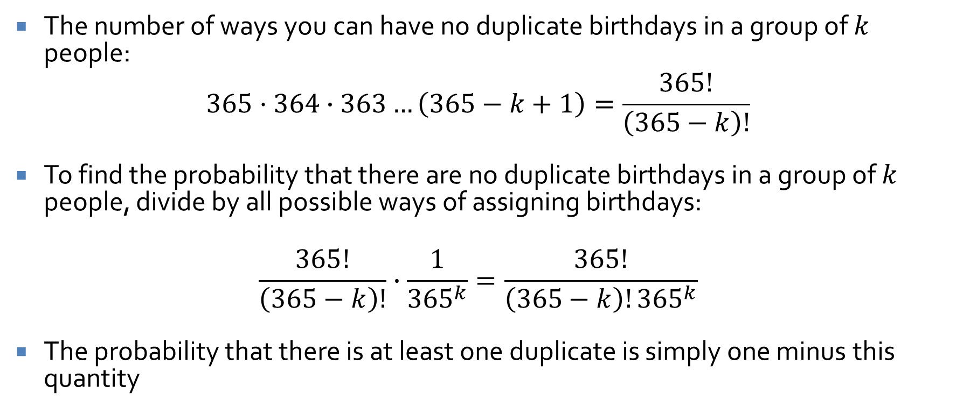
Birthday paradox: the math
The number of ways you can have no duplicate birthdays in a group of $k$ people:
$$365·364∙363…\left(365−k+1\right)=\frac{365!}{\left(365−k\right)!}$$
To find the probability that there are no duplicate birthdays in a group of $k$ people, divide by all possible ways of assigning birthdays:
$$\frac{365!}{\left(365−k\right)!}∙\frac{1}{{365}^{k}}=\frac{365!}{\left(365−k\right)!{365}^{k}}$$
The probability that there is at least one duplicate is simply one minus this quantity

Slide 25
Probabilities for groups of various sizes
People (k) | Probability of Collision
10 | 12%
20 | 41%
23 | 50.7%
30 | 70%
40 | 89%
50 | 97%
100 | 99.99996%

Slide 26
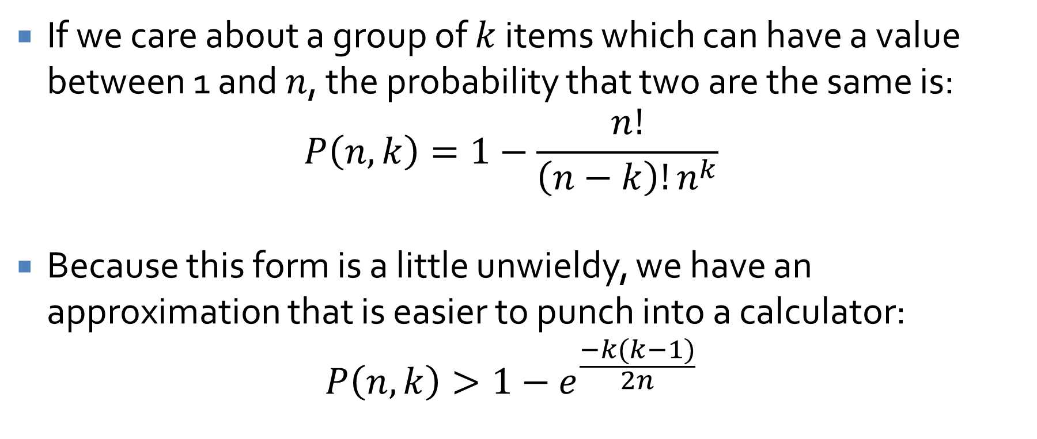
General case
If we care about a group of $k$ items which can have a value between 1 and $n$, the probability that two are the same is:
$$P\left(n,k\right)=1−\frac{n!}{\left(n−k\right)!n^{k}}$$
Because this form is a little unwieldy, we have an approximation that is easier to punch into a calculator:
$$P\left(n,k\right)>1−e^{\frac{−k(k−1)}{2n}}$$

Slide 27
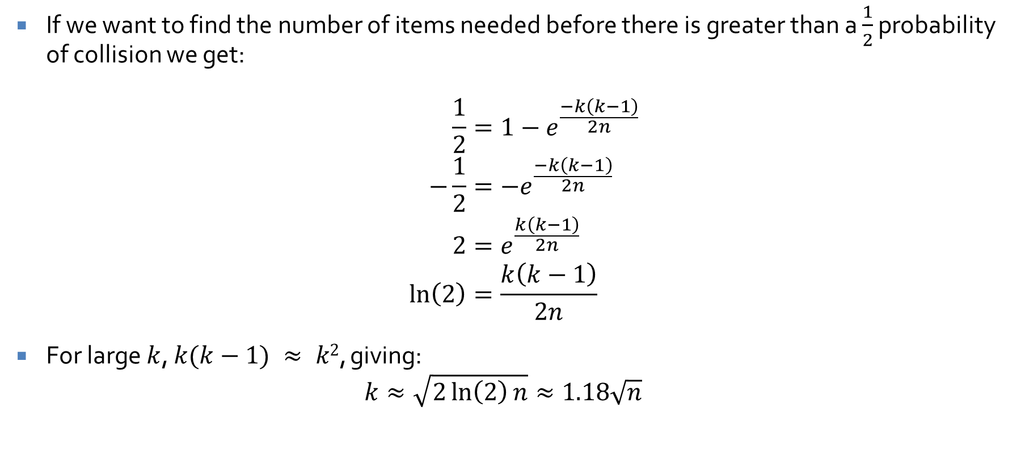
Count it up
If we want to find the number of items needed before there is greater than a $\frac{1}{2}$ probability of collision we get:
$$\frac{1}{2}=1−e^{\frac{−k\left(k−1\right)}{2n}} \\ −\frac{1}{2}=−e^{\frac{−k\left(k−1\right)}{2n}} \\ 2=e^{\frac{k\left(k−1\right)}{2n}} \\ \ln\left(2\right)=\frac{k\left(k−1\right)}{2n}$$
For large $k$, $k(k−1) ≈ k2$, giving:
$$k≈\sqrt{2\ln\left(2\right)n}≈1.18\sqrt{n}$$

Slide 28
Upcoming

Slide 29
Next time…
Attacks on hash functions
Digital signatures
Review for Exam 1
Jennifer Perez presents

Slide 30
Reminders
Review Chapters 1, 2, and 12
Finish Assignment 2
Due Friday
Start on Project 2

